Slide 1
JavaScript - language

Slide 2
Requirements
Must have Node installed
Must have Chrome installed
Use an IDE or Nodepad

Slide 3
Overview
What is JavaScript
What is ECMAScript
JavaScript - the Basics

Slide 4
JavaScript

Slide 5
JavaScript
Object-oriented
Scripting language
Depends on Browser or Node to execute

Slide 6
Client-side
Javascript can be executed by browsers
The browser extends Javascript to:
Manipulate DOM (Data Object Model)
Interact with services from the browser

Slide 7
Server-side
Executed by Node
Extended with objects to
Interact with IO
Interact with Sockets

Slide 8
History
Developed by Netscape / Brendan Eich
1995
September - LiveScript
December - JavaScript

Slide 9
ECMAScript

Slide 10
ECMAScript
Netscape asked Ecma International to create specification
Started in 1996, first release in 1997
Notes:
ECMA = European Computer Manufacturers Association

Slide 11
ECMAScript
First version of ECMAScript was based on JavaScript
All implementations are based on ECMAScript
Only defines Core of the language
DOM is maintained by W3C

Slide 12
JavaScript
The Basics

Slide 13
Starting point:
MDN Web docs
https://developer.mozilla.org/en-US/docs/Web/JavaScript/Guide/Introduction

Slide 14
What is JavaScript?
JavaScript is a cross-platform, object-oriented scripting language used to make webpages interactive.
Notes:
For example, client-side extensions allow an application to place elements on an HTML form and respond to user events such as mouse clicks, form input, and page navigation.

Slide 15
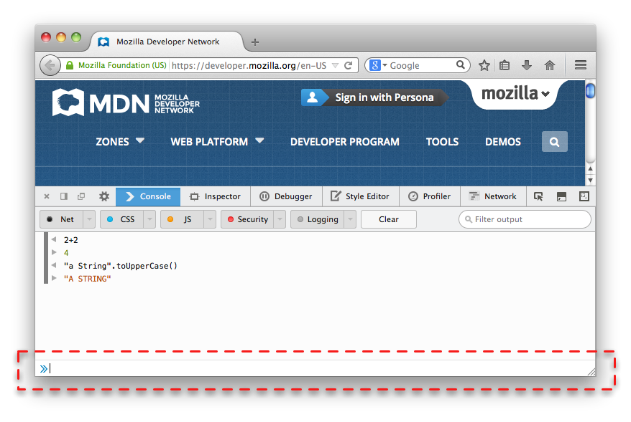
Browser Console
Internet Explorer F12
Chrome - View > Developer > JavaScript Console
Notes:
Nearly every browser can run JavaScript and most modern browsers now include a JavaScript console that can be used to run snippets of JavaScript code.

Slide 16
Your First JavaScript Program
Plaats de volgende code in de Browser Console:
console.log("Hello World!");

Slide 17
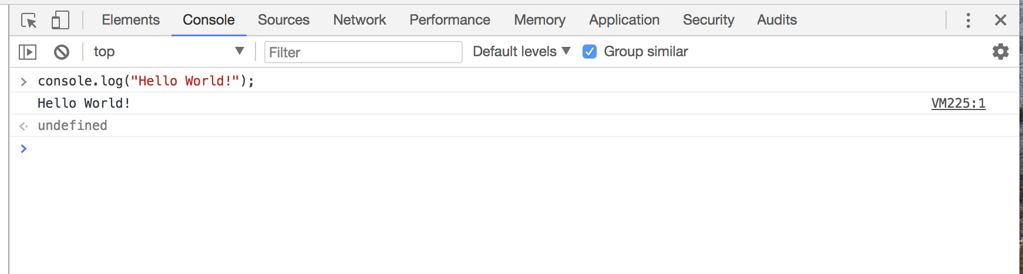

Slide 18
Three Layers of the Web

Slide 19
Keep all of these layers separate
JavaScript in a .js-file
CSS styling in a .css-file
HTML in a .html-file

Slide 20
Tutorial
https://developer.mozilla.org/en-US/docs/Learn/Getting_started_with_the_web/JavaScript_basics

Slide 21
Download
https://github.com/mdn/beginner-html-site-styled/archive/gh-pages.zip
Notes:
Calculator: http://embed.plnkr.co/YB9vnC/

Slide 22
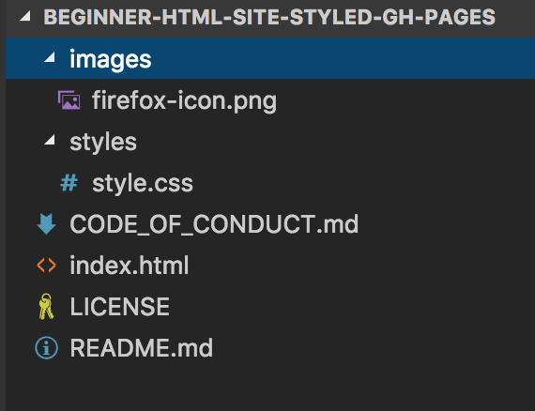

Slide 23


Slide 24
<!DOCTYPE html>
<html>
<head>
</head>
<body>
</body>
</html>

Slide 25
<!DOCTYPE html>
<html>
<head>
<meta charset="utf-8">
<title>My test page</title>
<link href="styles/style.css" rel="stylesheet" type="text/css">
</head>
<body>
<h1>Mozilla is cool</h1>
<img src="images/firefox-icon.png" alt="The Firefox logo: a flaming fox.">
</body>
</html>

Slide 27
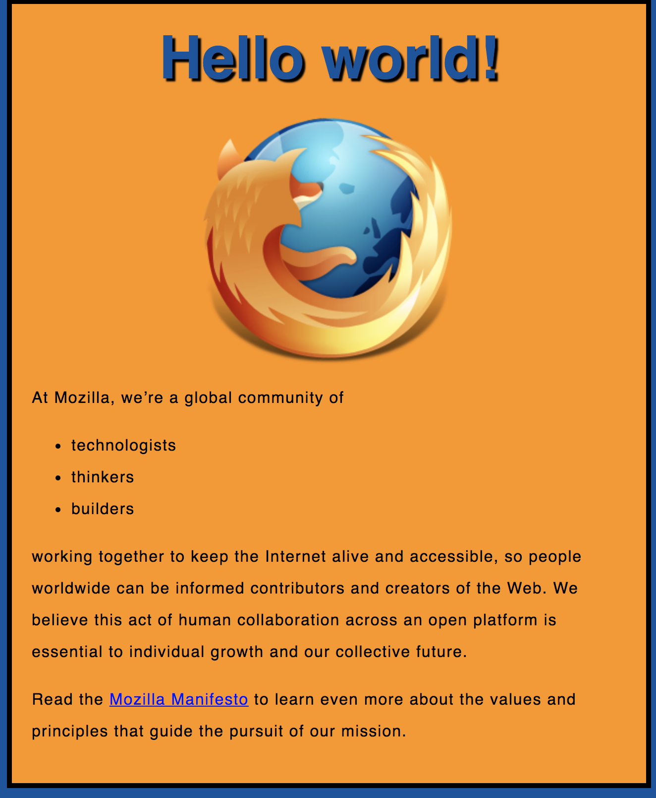
Exercise 1

Slide 28
Exercise 1
Create a new file called main.js
Save it in your scripts folder.

Slide 29
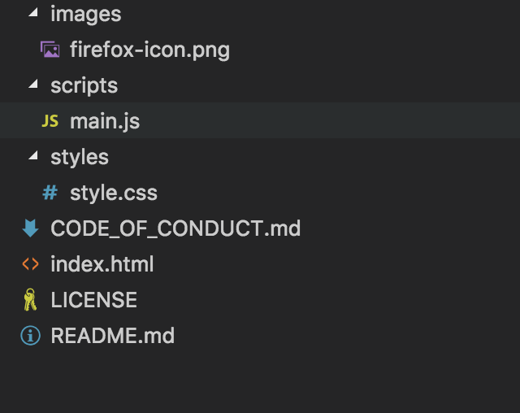

Slide 30
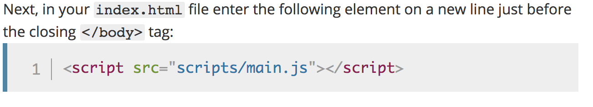

Slide 31
<!DOCTYPE html>
<html>
<head>
<meta charset="utf-8">
<title>My test page</title>
<link href="styles/style.css" rel="stylesheet" type="text/css">
</head>
<body>
<h1>Mozilla is cool</h1>
<img src="images/firefox-icon.png" alt="The Firefox logo: a flaming fox.">
<script src="scripts/main.js"></script>
</body>
</html>
Notes:
Note: The reason we've put the <script> element near the bottom of the HTML file is that HTML is loaded by the browser in the order it appears in the file. If the JavaScript is loaded first and it is supposed to affect the HTML below it, it might not work, as the JavaScript would be loaded before the HTML it is supposed to work on. Therefore, putting JavaScript near the bottom of the HTML page is often the best strategy.

Slide 32
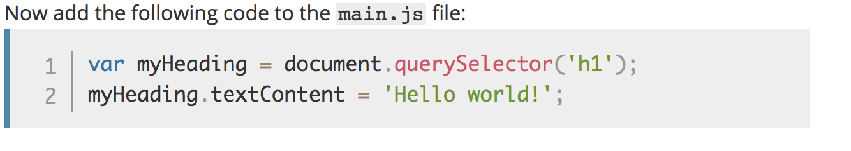
Notes:
Note: Both of the features you used above are parts of the Document Object Model (DOM) API, which allows you to manipulate documents.

Slide 34
Variables

Slide 35
Variables
JavaScript is case-sensitive
var myVar = "foobar";
var MyVar = "foobar";

Slide 36
Variables
var a, b, c;
var a = 3;
var d = 10, e = 10;
f = 22;
var pi = 3.14159;
var s = 'a', t = "t";

Slide 37
Identifiers
Must start with either “$”, “_” or a letter
Subsequent letters can be “$”, “_”, letter, numbers
var 1abc = 3; // Invalid
var $123 = 3; // Valid
Notes:
Identifier = variabelenaam.

Slide 38
Types
“Primitive” value types
Number (floating point)
String
Boolean
null
undefined
Notes:
null = NIL
undefined= niet geinitializeerd.

Slide 39
Built-in values
true & false
null
undefined
NaN (=Not A Number)
Infinity

Slide 40
Conditionals

Slide 41
“” vs ‘’
var x = "test"; /* yields the same as */
var y = 'test';

Slide 42
Conditionals
if (expression1) {
//Executes when expression1 is truthy
} else if (expression2) {
//Executes when expression2 is truthy
} else {
//Executes when none of the above conditions are truthy
}

Slide 43
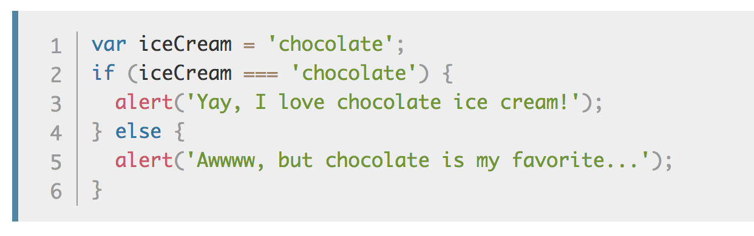
Conditionals

Slide 44
Truthy Falsy
Falsy values:
false, null, undefined, 0, ‘’, NaN
Truthy values:
Everything else

Slide 45
if (null) { // false
} else if (0) { // false
} else if ('') { // false
} else if (1) { // true
}

Slide 46
== vs ===
== performs type coercion
tries to match types for comparison
=== does NOT perform type coercion
will fail if type is different
Notes:
== Coercion: cast gelijk de datatypes.
===

Slide 47
Conditionals

Slide 48
Example
"" === 0 // false
"" == 0 // true
'0' == 0 // true
false == '0' // true
4 != '4' // false
4 !== '4' // false
Try to use ===, !==
instead of ==, !=

Slide 49
Infix operators same as Java
var x = 4;
if (x > 3 && x < 6) {
} else if (x > 3 || x === 2) {
}

Slide 50
Functions

Slide 51
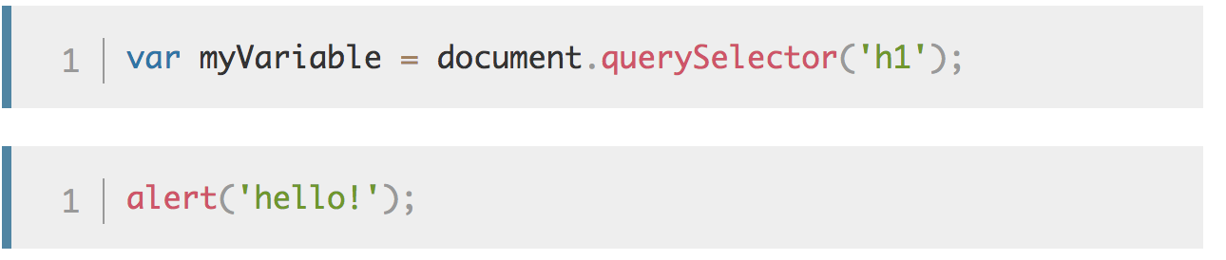
Functions = Procedure
Notes:
If you see something which looks like a variable name, but has parentheses — () — after it, it is likely a function.

Slide 52
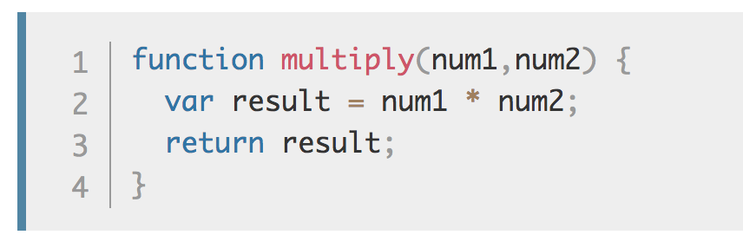
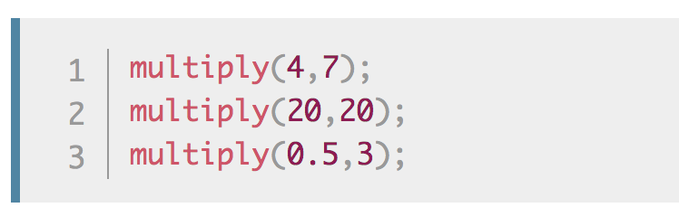
Make your own functions
Notes:
Note: The return statement tells the browser to return the result variable out of the function so it is available to use.
This is necessary because variables defined inside functions are only available inside those functions.
This is called variable scoping.

Slide 53
Use of “var”
Local
When used inside a function
Global
When outside a function
When ‘var’ is omitted (!)

Slide 54
Functions
Functions are first class objects
Can be created on their own
function foo() {}
Can assigned to a variable
var x = function() {}

Slide 55
Events
Examples when Events are executed:
clicked on a button
clicked on a page
pressed on enter-key

Slide 56
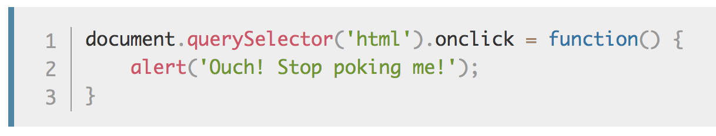
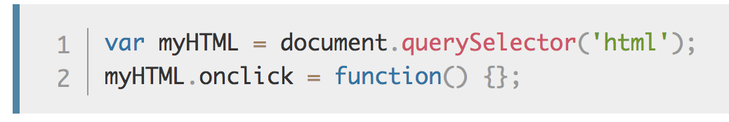
onclick Event

Slide 57
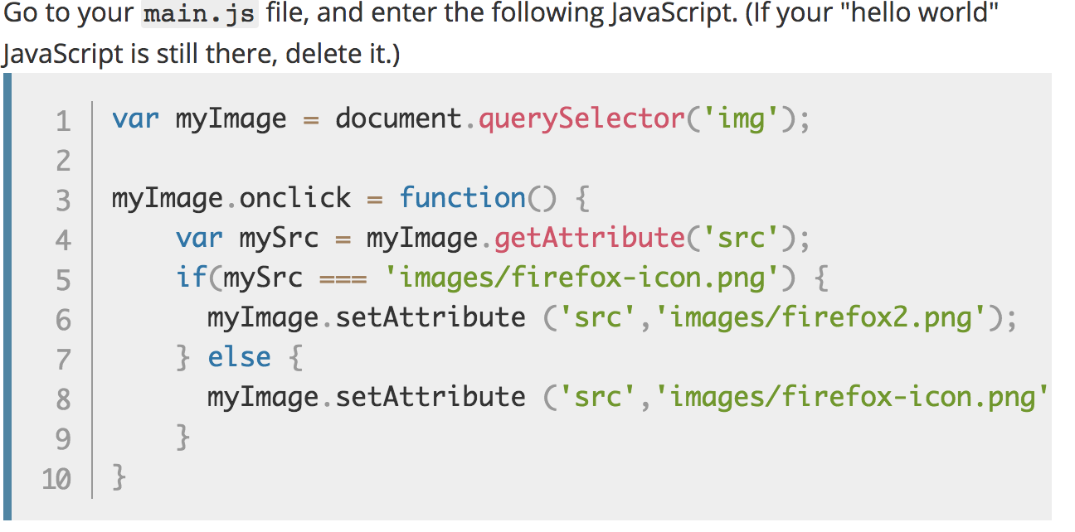
Exercise 2
Notes:
You store a reference to your <img> element in the myImage variable. Next, you make this variable's onclick event handler property equal to a function with no name (an "anonymous" function). Now, every time this element is clicked:

Slide 58
Exercise 3
Adding a personalized welcome message

Slide 59
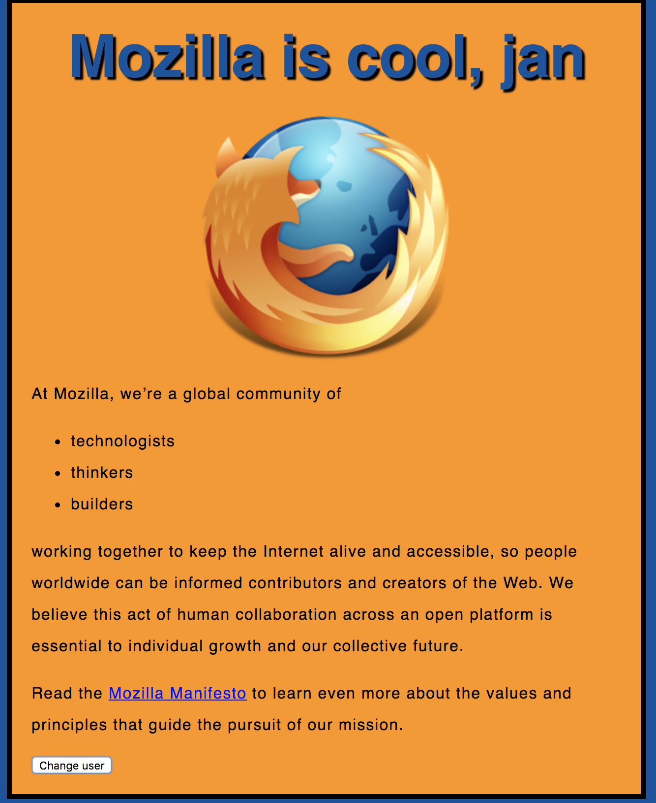

Slide 60
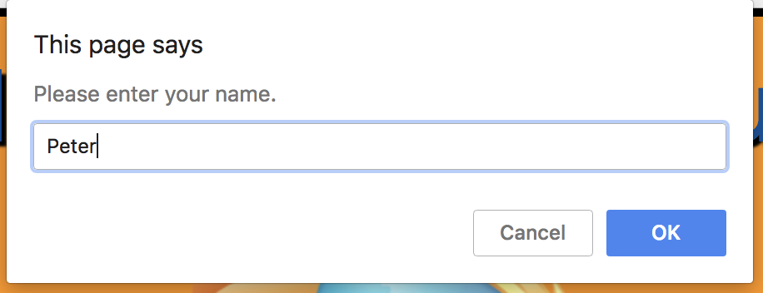

Slide 61
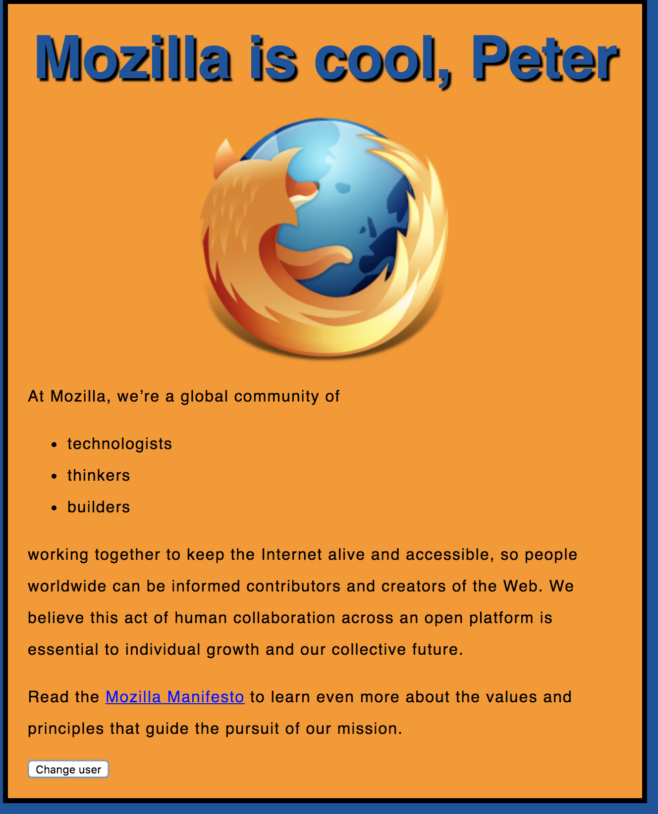

Slide 62
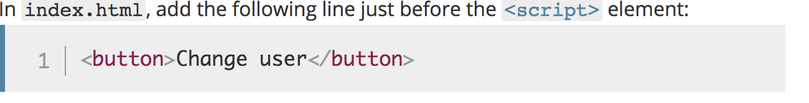

Slide 63
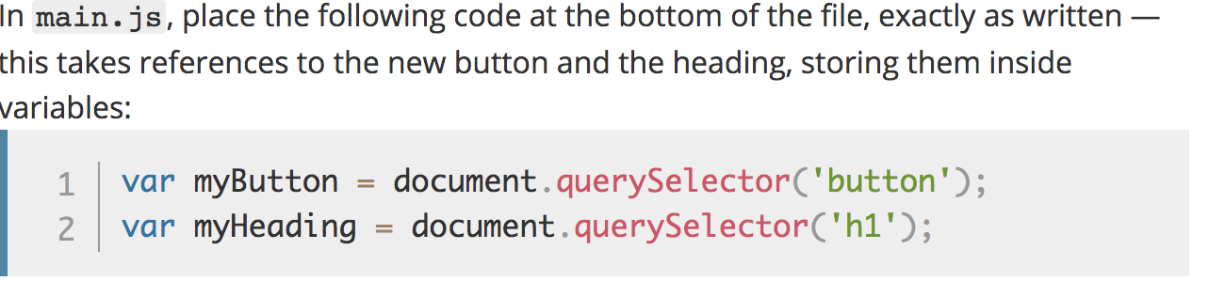

Slide 64
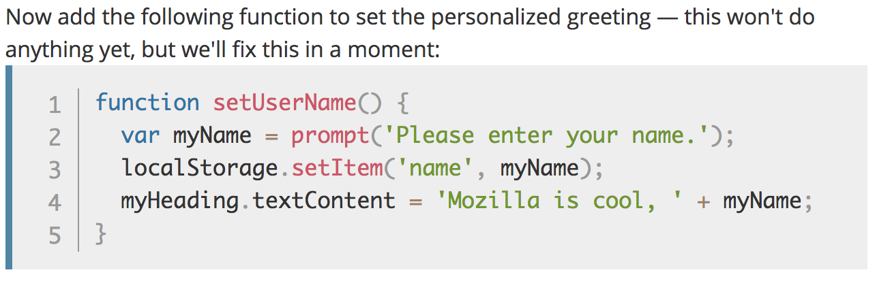

Slide 65
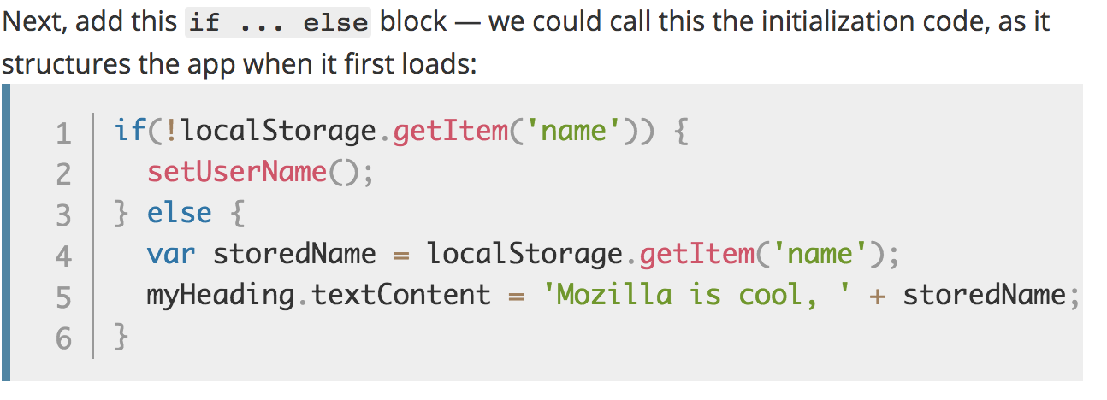

Slide 66
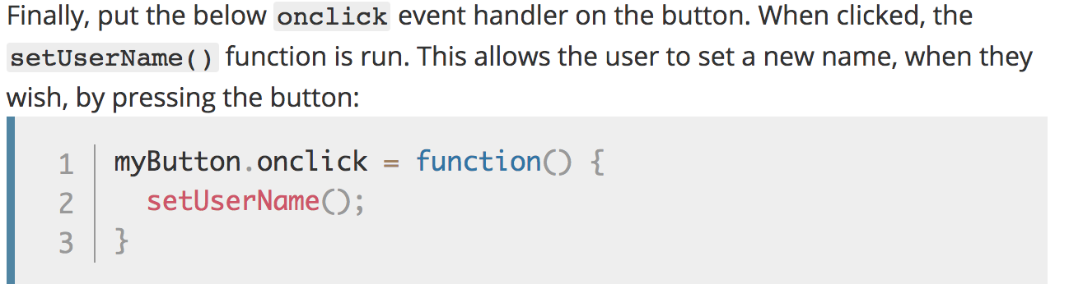

Slide 67
Solution
https://github.com/mdn/beginner-html-site-scripted/blob/gh-pages/scripts/main.js

Slide 68
Iterators/ Loops

Slide 69
Iterators
while (expression) { .. }
for (init; expression; update) { .. }
for (variable of object) { .. }
for (variable in object) { .. }

Slide 70
var list = [4, 5, 6];
for (var in list) { console.log(i); // "0", "1", "2" }
for (var i of list) { console.log(i); // "4", "5", "6" }

Slide 71
Arrays

Slide 72
Arrays
var beers = ['Heineken', 'Amstel', 'Jupiler'];
var cars = new Array("Saab", "Volvo", "BMW");
console.log(beers.length); // output is 3
var x = beers[0]; // x => 'Heineken'

Slide 73
Arrays
var beers = ['Heineken', 'Amstel', 'Jupiler'];
beers[5] = 'Palm';
console.log(beers.length); // output is 6 (!)
console.log(beers[3]); // output is undefined (!)
beers = [ , 'Heineken', , 'Amstel'];
console.log(beers.length); // output is 4 (!)

Slide 74
Objects

Slide 75
Objects
var car = new Object();
car.make = 'Ford';
car.model = 'Mustang';
car.year = 1969;

Slide 76
Associative Array /
Dictionary
var car = new Object();
car['make'] = 'Ford';
car['model'] = 'Mustang';
car['year'] = 1969;

Slide 77
JSON
var car = {
make: 'Ford',
model: 'Mustang',
year: 1969
};

Slide 78
JSON

Slide 79
JSON
JavaScript Object Notation
A common use of JSON is:
to exchange data to/from a web server.

Slide 80
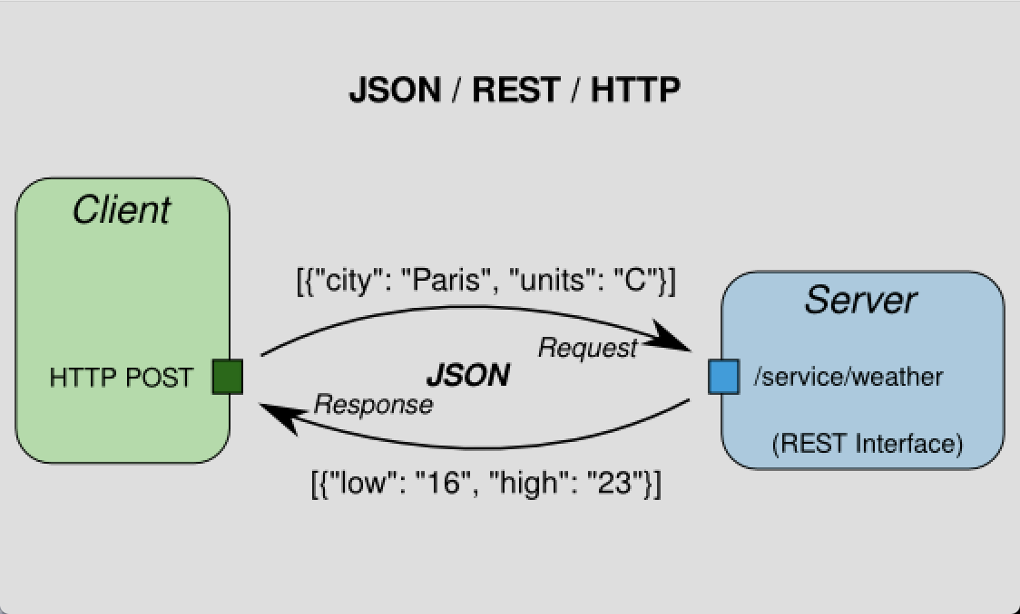

Slide 81
Valid JSON
var obj = {
"name":"John",
"age":30,
"city":"New York”
};

Slide 82
JSON
For parsing use:
var json = JSON.parse('{..}')
var jsonString = JSON.stringify({..});
Notes:
PARSE:
When receiving data from a web server, the data is always a string.
Parse the data with JSON.parse(), and the data becomes a JavaScript object.
STRINGIFY:
When sending data to a web server, the data has to be a string.
Convert a JavaScript object into a string with JSON.stringify().

Slide 83
JSON.parse(v)
Parse the data with JSON.parse(), and the data becomes a JavaScript object.
See: https://www.w3schools.com/js/js_json_parse.asp

Slide 84
JSON.stringify( )
Convert a JavaScript object into a string with JSON.stringify().
See: https://www.w3schools.com/js/js_json_stringify.asp

Slide 85
Valid JSON
var obj = {
property: 'Foo',
2: 'Bar',
something: true,
'say what': 'allowed'
};

Slide 86
Debugging in Chrome

Slide 87


Slide 88
Node.js provides a JavaScript runtime environment

Slide 89
Goals
Provide a JavaScript runtime environment
Event-driven, non-blocking I/O
fast/lightweight

Slide 90
Applications
Can be used to create Tools, applications or services
Powered by Chrome’s V8 JavaScript engine
npm, package ecosystem

Slide 91

History
First written in 2009
By Ryan Dahl
2010 package manager npm
2011 native Windows version

Slide 92
Utilities
Node comes with the following:
I/O, Sockets(http/dns/udp/etc), crypto functions, data streams
Runs on Linux, Mac, Windows

Slide 93
Opdracht Node
Open map:
2- Node
Opdracht:
Implement a directory walker

Slide 94
Opdracht Node
How to read recursively a directory in Node.js

Slide 95
Readme
Open Readme for instructions

Slide 96
Package.json
Package.json is important for NPM.
With this file you can declare all your dependencies and install them.

Slide 97
Step 1
Open your prompt/shell/terminal in this directory
and type: `npm install --save filewalker`

Slide 98
What is generated
A couple of things have happened:
NPM installed the `filewalker` dependency locally in the node_modules folder
NPM add `filewalker` to the dependency list in package.json

Slide 99
Great!
This means that we are now able to use this dependency.

Slide 100
Step 2 Use the dependency
Open:
`nodeScript.js`

Slide 101
First we need to require the dependency.
Add the following in your nodeScript:
const filewalker = require('filewalker');

Slide 102
Step 3
Using the following code we can traverse a directory:
filewalker('A_DIRECTORY')
.on('dir', p => console.log('dir: %s', p))
.walk();

Slide 103
Step 4 Execute script
node nodeScript.js

Slide 104
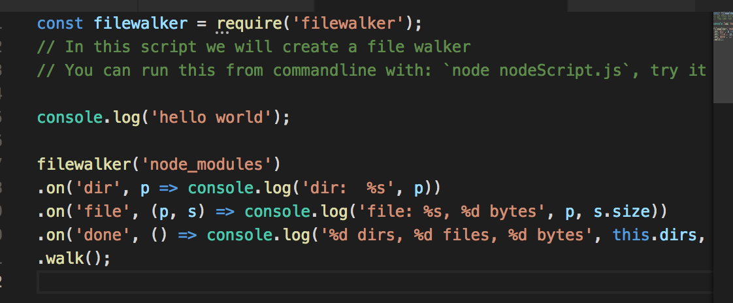

Slide 105
Additional information
If the material was too advanced, have a look at http://www.w3schools.com/js/
If the material was to easy, have a look at https://learnxinyminutes.com/docs/javascript/

